Slide 1
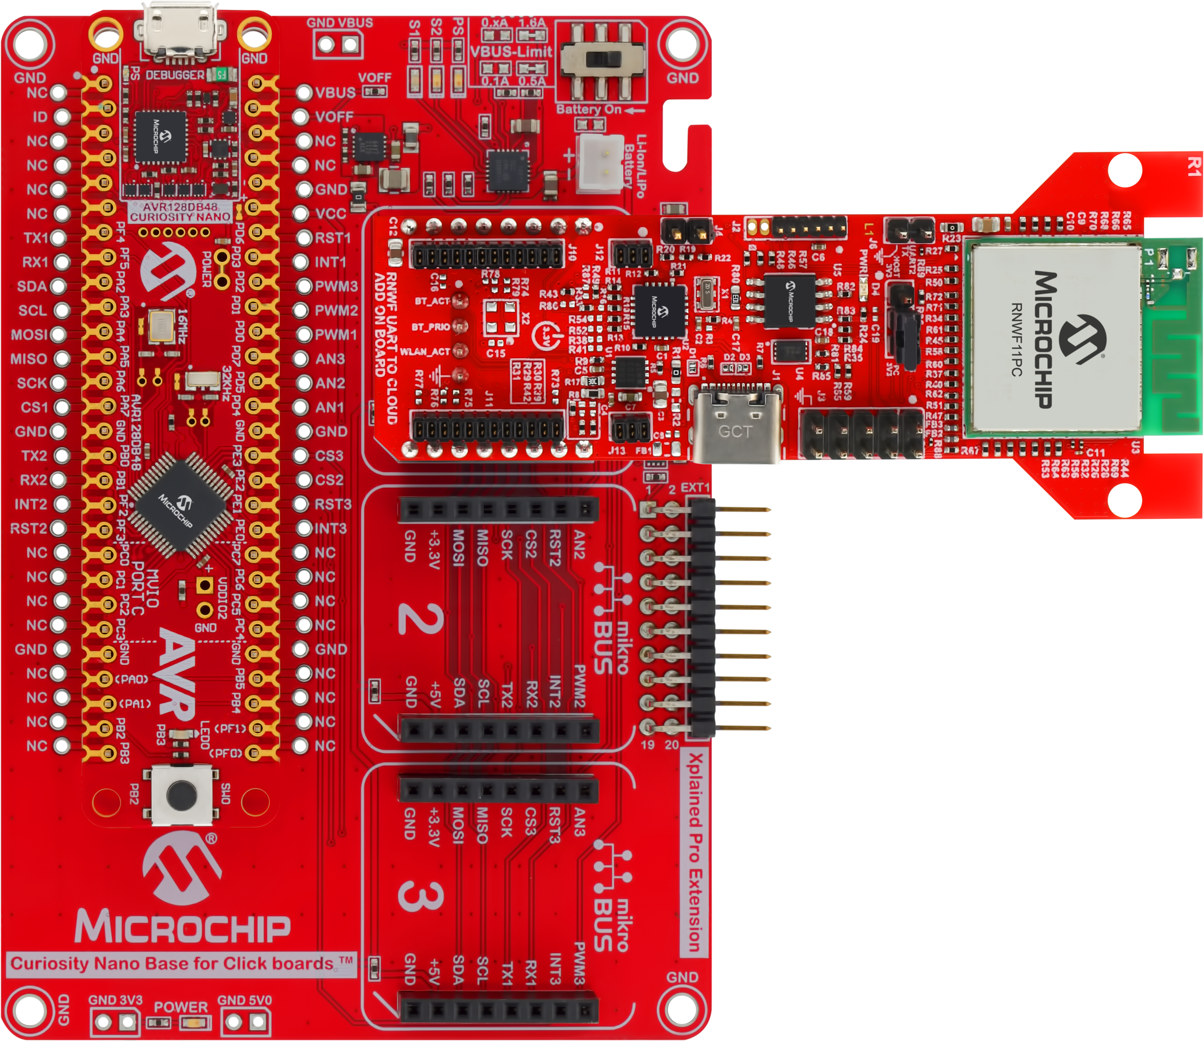
RNWF UART to Cloud Add On Board
AVR128DB48 Curiosity Nano Board
Curiosity Nano Base for Click boards

